Slide 1
Connections and resources for teachers, programs, and parents
Shuhan C. Wang, PhD
Joy Kreeft Peyton, PhD
Ting Shen, PhD
CELIN at Asia Society
NCLC 2020
June 25, 2020
Notes:
Shuhan - 5 minutes - CELIN staff, mission,

Slide 2
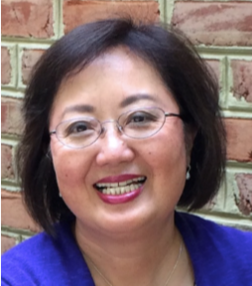
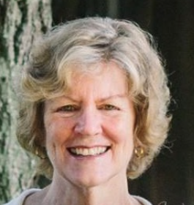
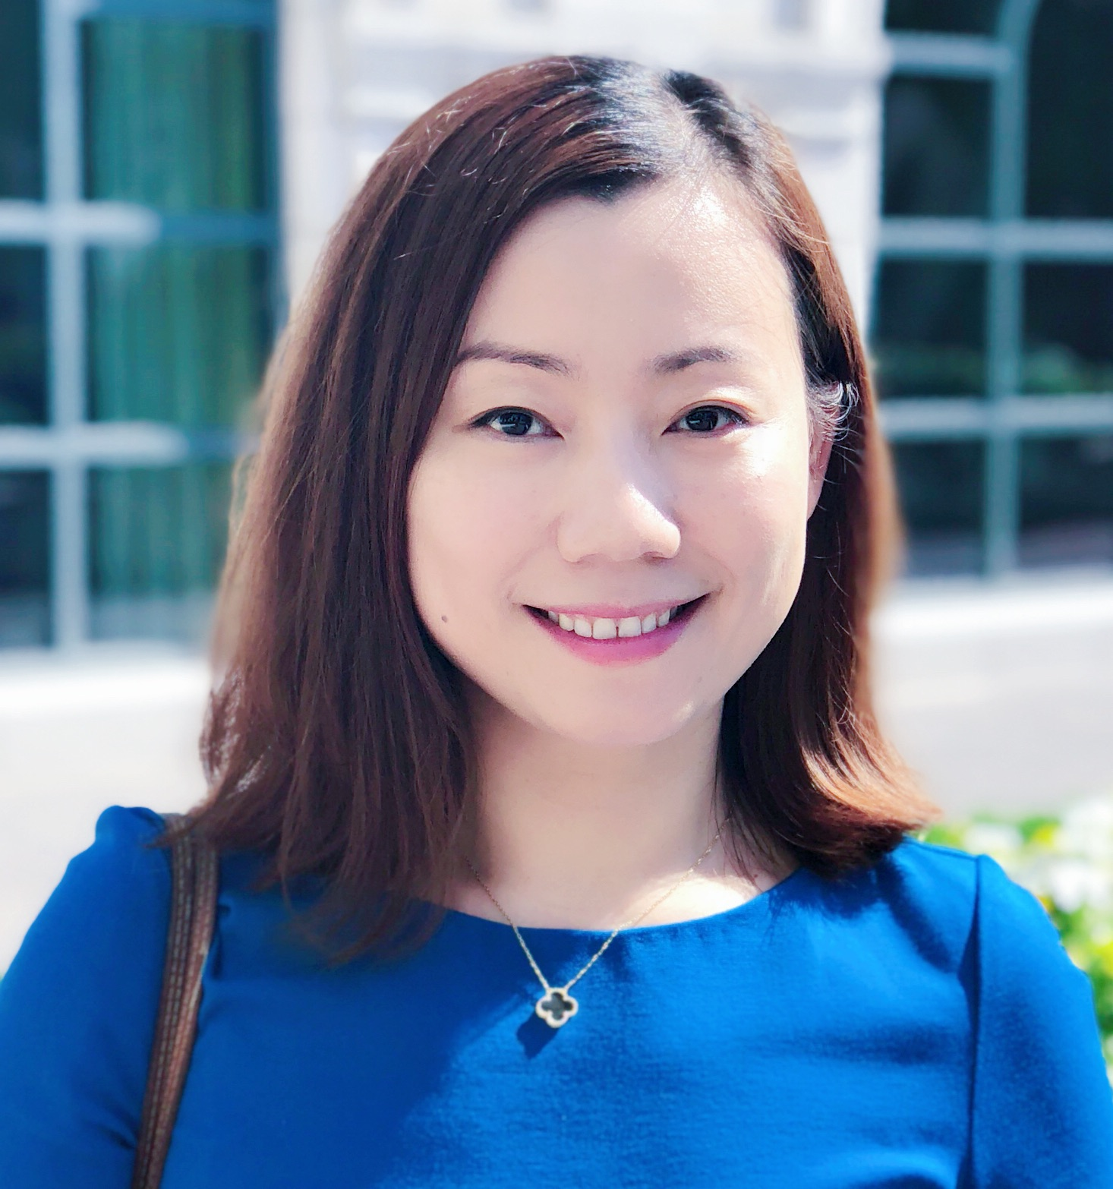
http://asiasociety.org/china-learning-initiatives/chinese-early-language-and-immersion-network
Chinese Early Language and Immersion Network: CELIN at Asia Society
Shuhan C. Wang Joy Kreeft Peyton Ting Shen
Notes:
Shuhan
Resources – Joy
20 minutes 3:50-4:10

Slide 3
Session Overview
We want to engage the field in knowing how we can further our service to the field!
Show how CELIN provides resources for educators, parents, and programs
Share information about Chinese language student and teacher program collections
Discuss new CELIN Initiatives
Invite your participation and collaboration

Slide 4
Mission
Support the growth and sustainability of Chinese early language and immersion programs in and outside the United States to ensure that students have opportunities to develop high-level multilingual and intercultural competency for advanced study and work in an interconnected world
Notes:
Shuhan
Invite Joy to speak for the next set of slides

Slide 5
CELIN Web Pages
Notes:
Joy – 15 minutes – CELIN web pages

Slide 6
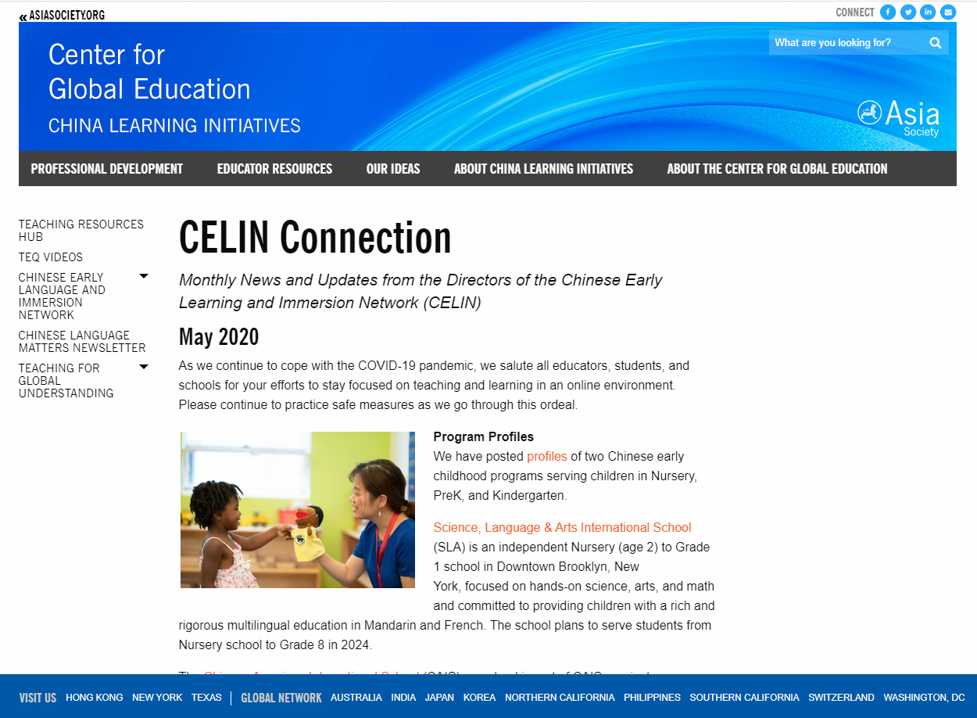
National Advisors Monthly Newsletter

Slide 7
Resources for Educators

Slide 8
Books and Articles/Resources for Educators
Notes:
https://asiasociety.org/china-learning-initiatives/books-and-articles-about-early-language-and-immersion-education

Slide 9
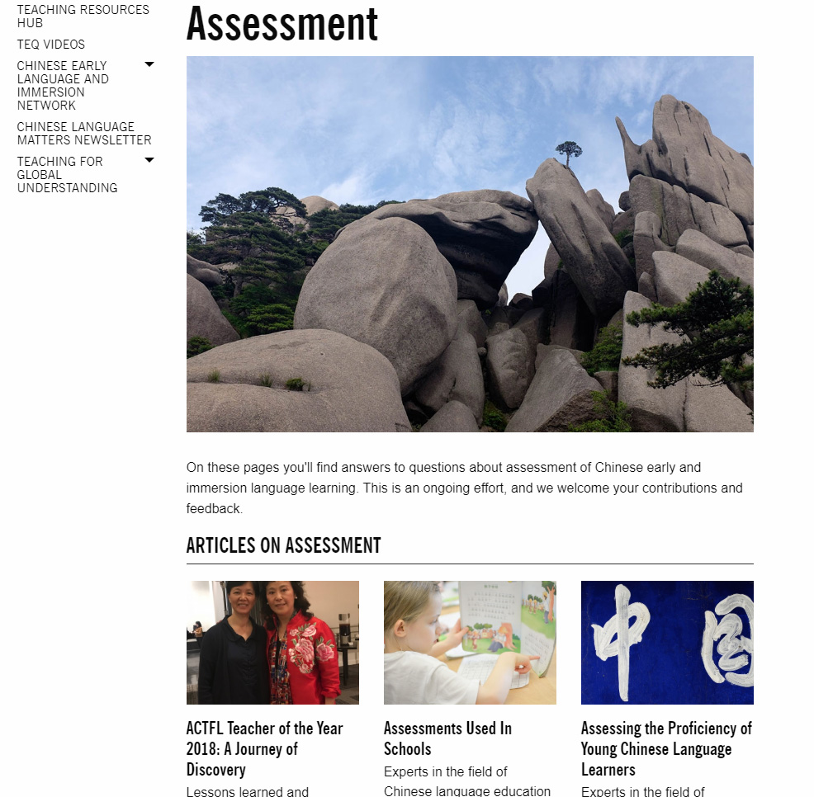
Assessment/Resources for Educators

Slide 10
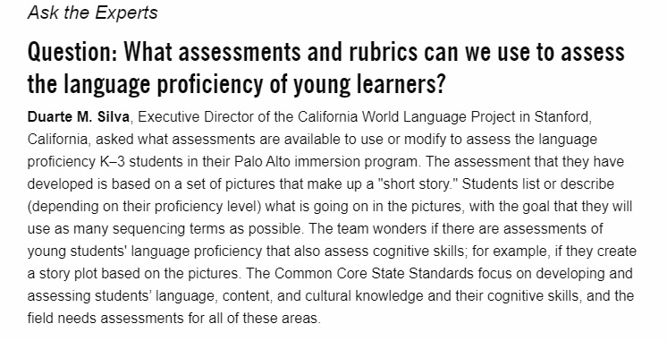
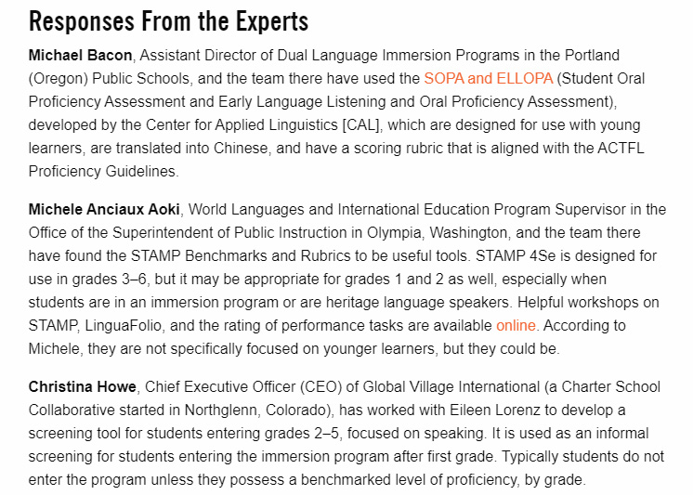
Assessing the Proficiency of Young Chinese Language Learners/
Resources for Educators

Slide 11
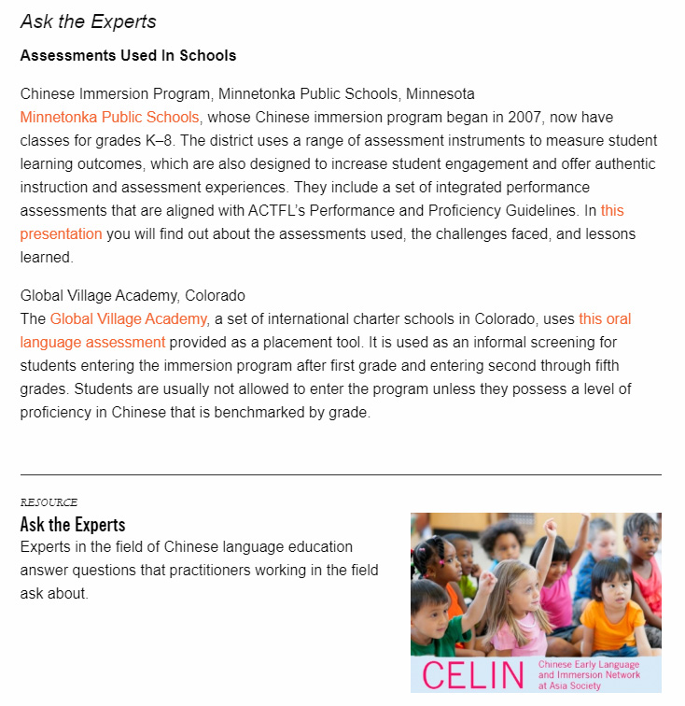
Assessments Used in Schools/
Resources for Educators/

Slide 12
Conference Presentations: 2014-2019 (Resources for Educators)
Notes:
https://asiasociety.org/china-learning-initiatives/conference-presentations

Slide 13
Be Bilingual – Practical Ideas for Multilingual Families by Annika Bourgogne The Bilingual Edge: Why, When and How to Teach Your Child a Second Language by Kendall King and Alison Mackey A Parent’s Guide to Mandarin Immersion by Elizabeth Weise
Resources for Parents: Books
Notes:
https://asiasociety.org/china-learning-initiatives/resources-parents

Slide 14
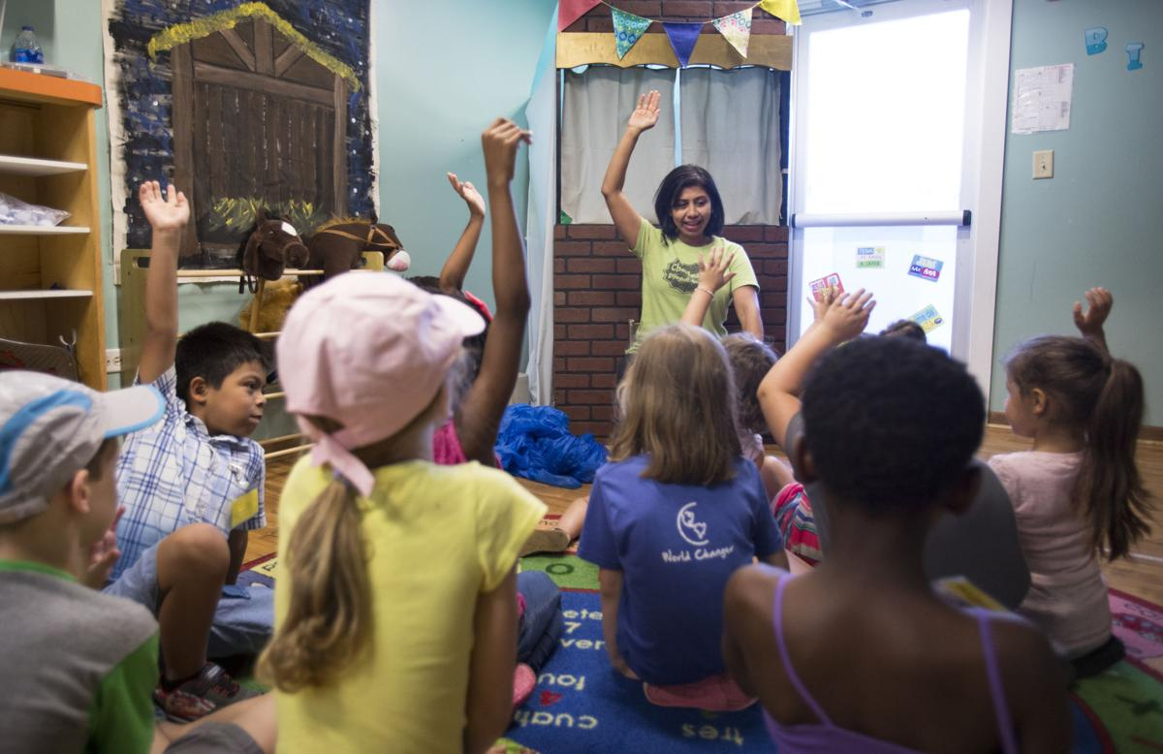
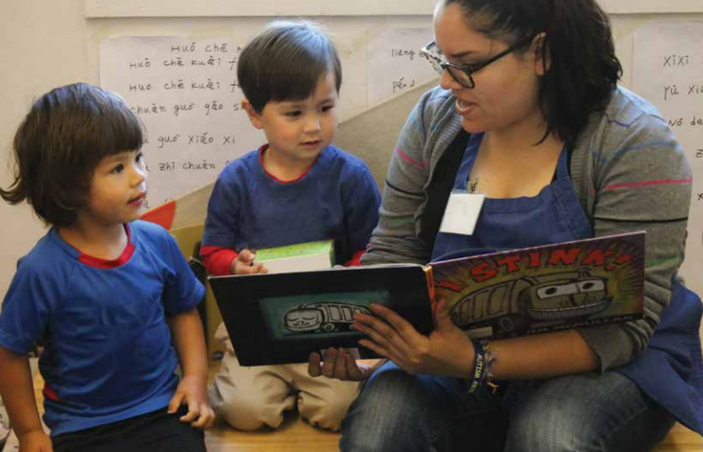
“Building Bridges: Strengthening Skills” by Jade Chan “Lessons for Americans, From a Chinese Classroom” by Perri Klass “Why Some Parents Choose Bilingual Education for Their Children” by Post and Courier “The Brain Science of Bilingualism” by Young Children
Articles and Blogs/Resources for Parents
Notes:
https://asiasociety.org/china-learning-initiatives/resources-parents

Slide 15
WEBSITES Mandarin Immersion Parents Council: An Information and News Site about Mandarin Immersion - http://miparentscouncil.org Chinese Immersion Schools: A Frequently Updated Map of U.S. Mandarin Immersion Schools - http://chineseimmersionschools.com Parents of African American Students Studying Chinese: A National Information and Support Site - http://paassc.com Asia Society Chinese Language Page: Often has Articles of Interest to Parents - http://asiasociety.org/education/world-languages/american-schools/chinese-language EMAIL LISTS Mandarin Immersion Schools: A National List for Parents with Children, Mandarin Immersion Programs - http://groups.yahoo.com/neo/groups/Mandarin_immersion/info Mandarin Trilingual: A List for Families that Speak Another Language at Home and Whose Children are Learning Mandarin - http://groups.yahoo.com/neo/groups/Mandarin_trilingual/info Cantonese Immersion Parents: A San Francisco-Based List for Parents with Students in Cantonese Immersion - http://groups.yahoo.com/neo/groups/SFCantoneseImmersion/info
Web Sites & Contacts/
Resources for Parents
Notes:
https://asiasociety.org/china-learning-initiatives/resources-parents

Slide 16
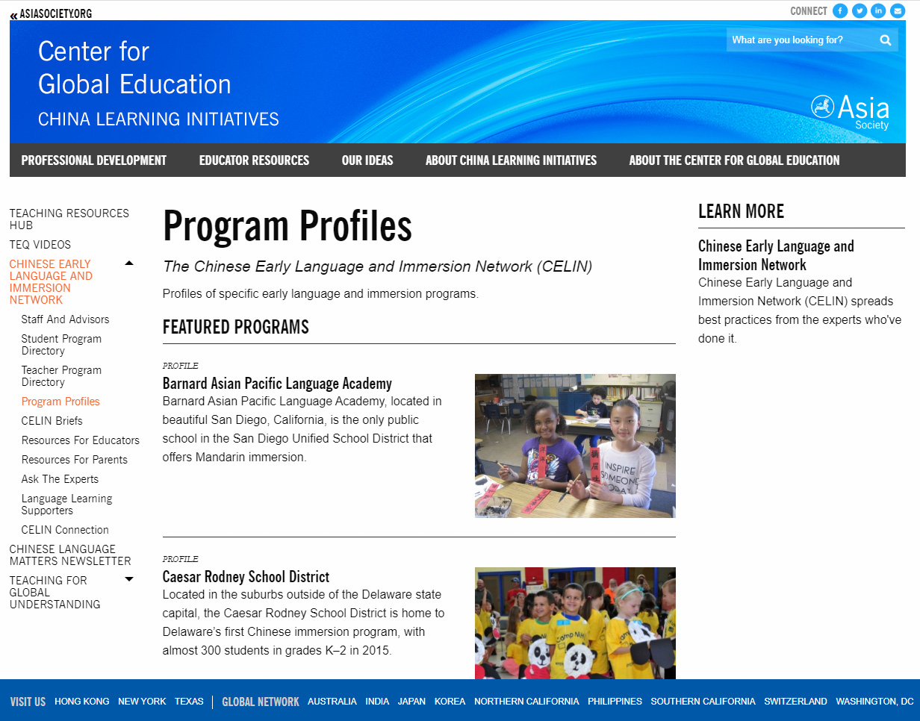
Program Profiles
http://asiasociety.org/china-learning-initiatives/program-profiles

Slide 17
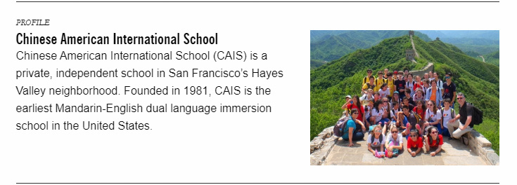
Program Profiles
http://asiasociety.org/china-learning-initiatives/program-profiles

Slide 18
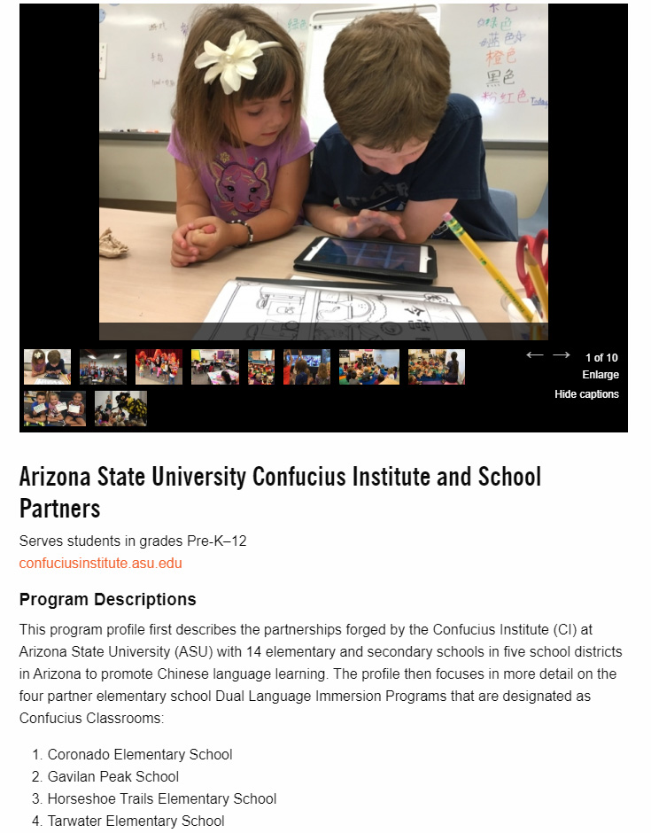
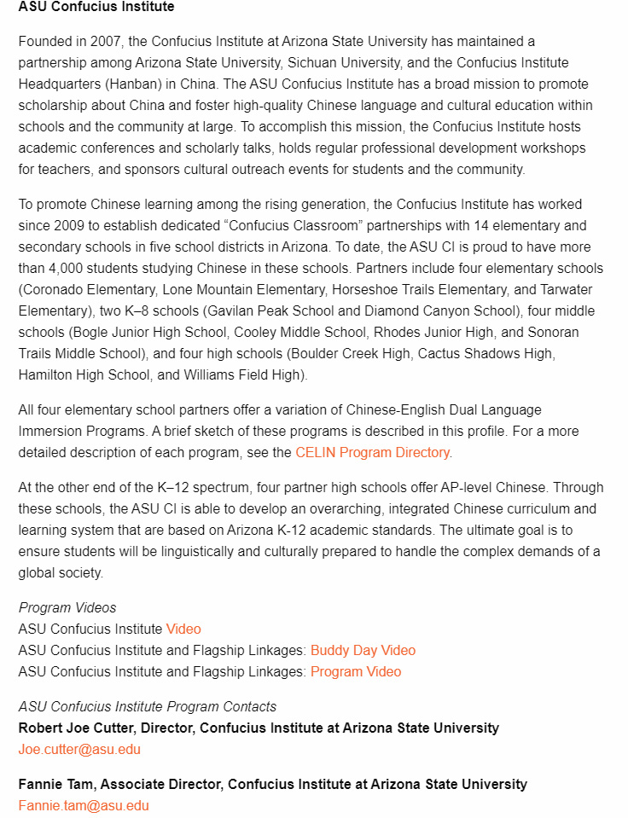
Program Profiles
The Confucius Institute at Arizona State University
https://asiasociety.org/china-learning-initiatives/confucius-institute-arizona-state-university

Slide 19
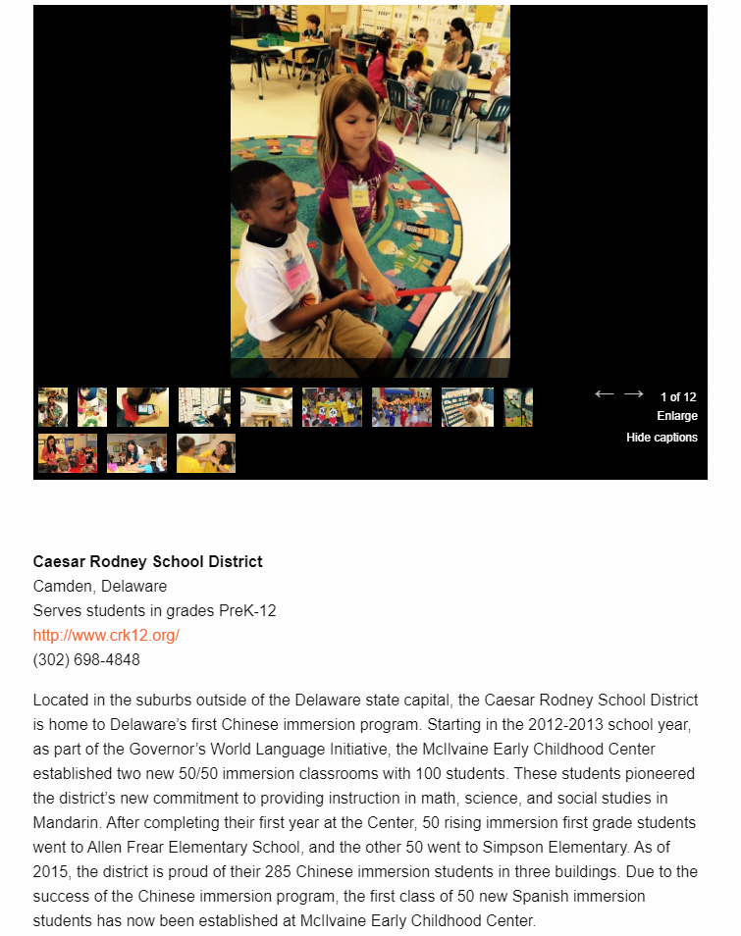
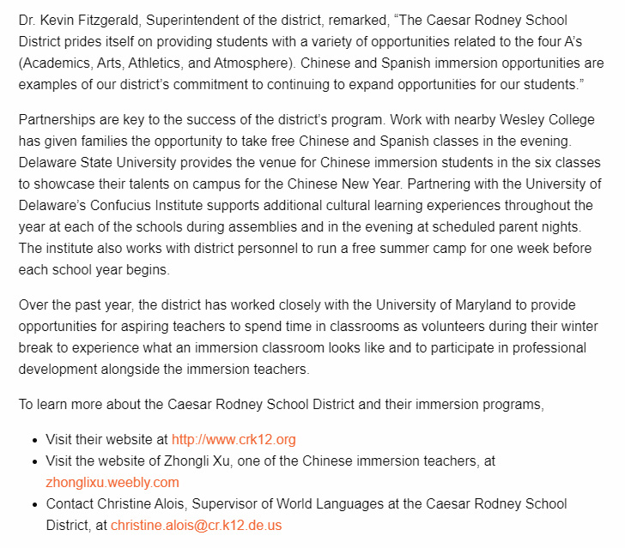
Program Profiles
Caesar Rodney School District
https://asiasociety.org/china-learning-initiatives/caesar-rodney-school-district

Slide 20
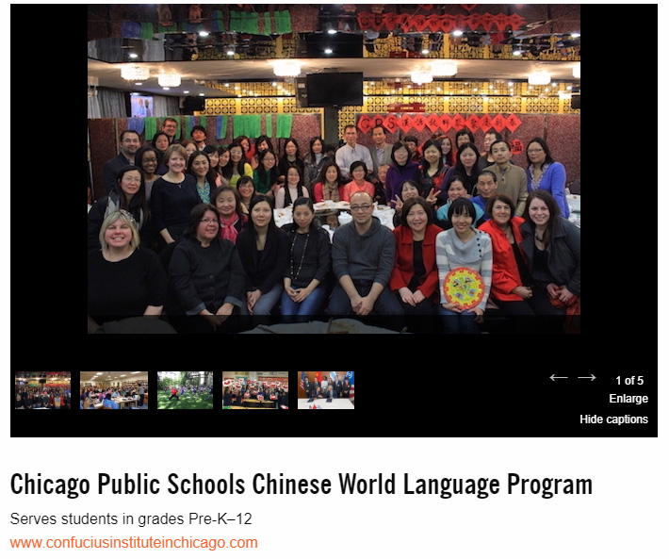
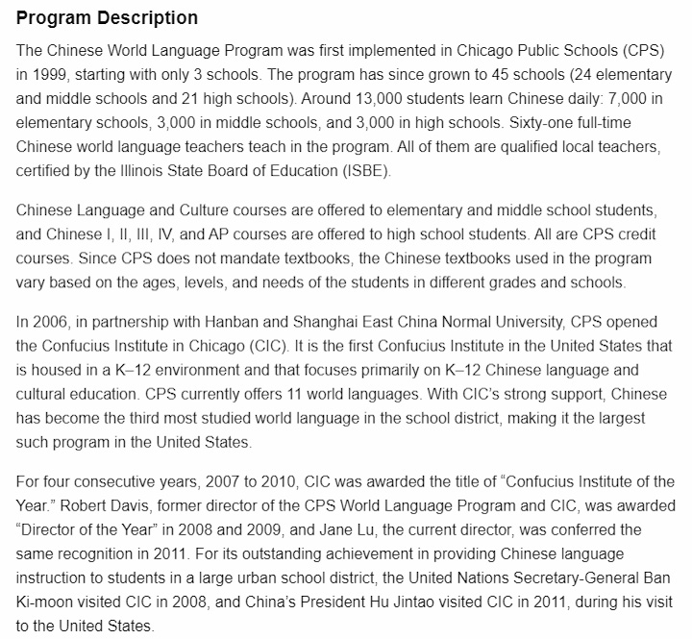
Program Profiles
Chicago Public Schools Chinese World Language Program
Teacher Professional Development
Student Extracurricular Programs
Integration of Language and Culture
Program Videos
https://asiasociety.org/china-learning-initiatives/chicago-public-schools-chinese-world-language-program

Slide 21
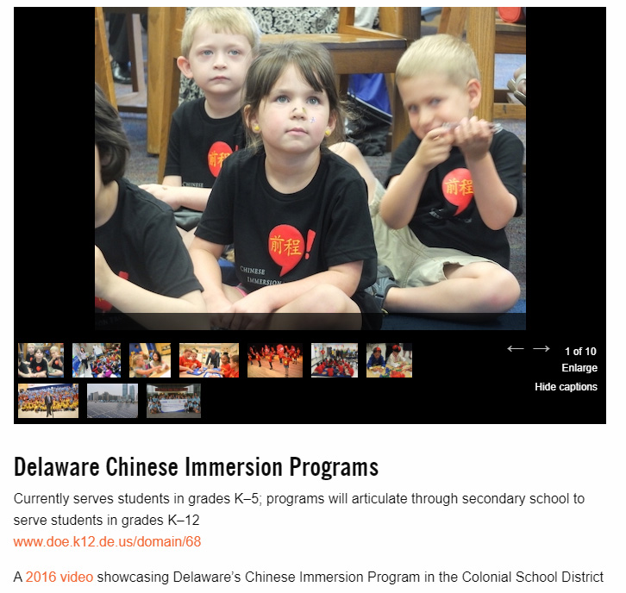
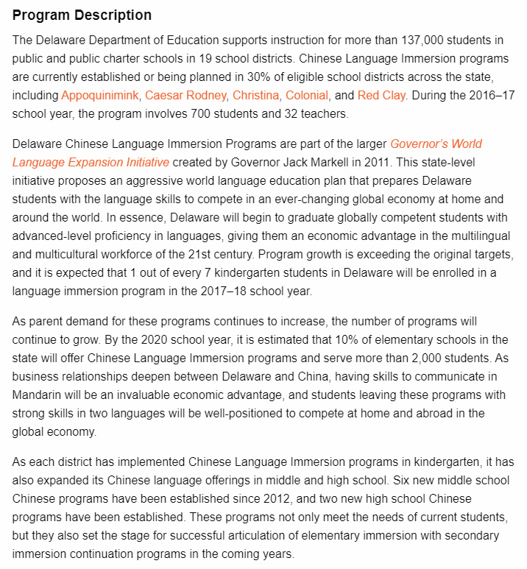
Program Profiles
Delaware Chinese Immersion Programs
https://asiasociety.org/china-learning-initiatives/delaware-chinese-immersion-programs

Slide 22
CELIN Briefs 专题指南系列
11 CELIN Briefs have been published
Available in English and in Chinese
CELIN Briefs Editors:
Shuhan C. Wang, Ph.D., shuhancw@gmail.com
Joy K. Peyton, Ph.D., joy@peytons.us
Find CELIN Briefs at: http://AsiaSociety.org/CELIN

Slide 23
Curriculum and Instruction
Designing and Implementing Chinese Language Programs: Preparing Students for the Real World
Curriculum, Instruction, and Assessment for Elementary Chinese and Immersion Programs
Learning Chinese in the Digital Age

Slide 24
Literacy and Learning Outcomes
Developing Initial Literacy in Chinese
Mapping Chinese Language Learning Outcomes in Grades K–12

Slide 25
Articulation and Integration
Making Middle and High School Mandarin Immersion Work
Immersion Education: Creating an Integrated School Culture

Slide 26
Teacher Development and Support
Cultivating Teacher Leaders to Advance the Field of Chinese Language and Culture Education
Recruiting and Supporting International Chinese Language Teachers in U.S. K–12 Programs

Slide 27
Collaborating With Parents
Parents as Partners in Their Children's Chinese Immersion Education: Making Decisions and Providing Support

Slide 28
CELIN Program Evaluation Checklist:
https://asiasociety.org/sites/default/files/inline-files/2018-celin-key-features-effective-chinese-language-programs-celin-checklist.pdf
Notes:
After this, Joy invites Ting to present

Slide 29
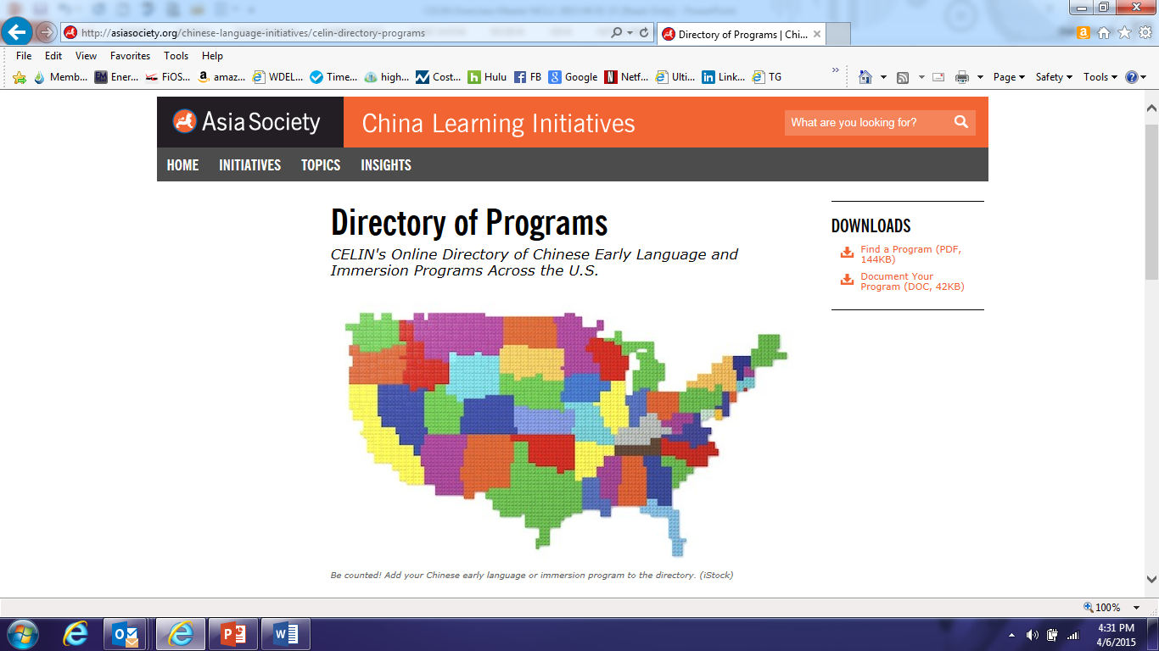
Small-Group Discussions – 15 minutes
CELIN Collections of Programs
1. CELIN's Online Directory of Student Chinese Early Language and Immersion Programs Across the U.S.
Searchable features: state, city, institute, grades
2. Teacher Programs
https://asiasociety.org/china-learning-initiatives/directory-programs
Notes:
Use this
Ting – 10 minutes
Directory of Student Programs
Please make sure that your program, and programs you know about, are included in the student program directory. You can also learn about other programs across the country here.
Directory of Teacher Programs
Please make sure that teacher programs you know about are included in the teacher program directory. You can also learn about other programs across the country here.
Ting, please find the CELIN email that AS gave us.

Slide 30
Small-Group Discussions – 15 minutes
Student Programs
Time | 10/2016 | 05/2018 | 05/2019 | 05/2020
Number of Programs | 179 | 339 | 393 | 428
Percentage of Change |  | 89% | 16% | 10%
Notes:
Ting, can you break it down to PK-G5, 6-8 or 6-12?
How many immersions? People will ask those questions.

Slide 31
Types of Programs
We started with K-5 programs, now we are also collecting early childhood (2 ⎯ 5 years old) and secondary school programs (G6 ⎯ G12).
Program Type | Number of Programs
Immersion Program | 150
PK-5 | 290
6-12 | 175

Slide 32
Small-Group Discussions – 15 minutes
Teacher Programs
Time | 01/2018 | 05/2018 | 05/2019 | 05/2020
Number of Programs | 0 | 42 | 60 | 93
Percentage of Change |  |  | 52% | 55%
Make sure your programs are included!
Notes:
Shuhan

Slide 33
Work in Progress
Update program information monthly
We are in the process of redesigning the database
Continue to improve the directory framework to ensure the information is more complete and easier to search
Please send us your program information to be included!
Email us: celin@asiasociety.org
Notes:
After this slide, Ting invites Shuhan to continue.

Slide 34
Five Major CELIN Initiatives

Slide 35
1. Chinese Early Childhood Education
CELIN at Asia Society Meetings, 2017 & February 2020, New York City, NY
Collaborating with Early Childhood Chinese Immersion Forum (ECCIF), San Francisco, CA
Co-developing with Avant Assessment an Assessment Protocol for Early Language Learners
Conducting National Surveys of Chinese Early Childhood Education

Slide 36
Pepperdine University and CELIN
Surveys of Early Childhood Education
Purpose: study the landscape and needs of Chinese early childhood education in the United States
Survey 1: Teachers and program administrators
https://docs.google.com/forms/d/e/1FAIpQLSdj7Iz15PEPDbFadrgwcyO0DkVOCEdJ0OnPzd8w9aKVYh7WuA/viewform
Survey 2: Chinese language and immersion early childhood programs
https://docs.google.com/forms/d/e/1FAIpQLSffNmWE3m-tLAUPs34kpDA1vRn3A8c6JiXETwFN96MZpqq1LQ/viewform
Timeframe----July 15, 2020
Notes:
Shuhan

Slide 37
2. CELIN Briefs in English and Chinese
The Field of Chinese Early Childhood Education
A Report of the National Surveys of Chinese Early Childhood Teachers and Programs
What topics would you be interested in learning more about?

Slide 38
3. CELIN Webinars
4-5 Webinars, in planning
August-September 2020
Will announce through the newsletter and social media
What would you like to know more about?

Slide 39
4. NCLC & Regional CELIN Forums
Washington Yuying, 2019
ECCIF, 2019
University of Washington, 2020
Michigan State University, 2019
Would you be interested in co-organizing one with CELIN?

Slide 40
1. Chinese Early Childhood Education
2. More Bilingual CELIN Briefs
3. CELIN Webinars
4. NCLC & Regional CELIN Forums
5. Continue Resource Building and Sharing
Notes:
Forums: NCLC Forums, Washington Yuying-CELIN Forum, Michigan State University-CELIN, University of Washington and CELIN

Slide 41
Discussion: Connections and Resources 1. Resources: - What topics would be of interest to you? - What additional resources would be helpful for you? - What resources can you share with us? 2. Student and Teacher Programs: - Is your program included? - What other programs to be included in our collections? 3. Ongoing and future Initiatives: - How can we connect with you? What else can we do for you?
Notes:
Forums: NCLC Forums, Washington Yuying-CELIN Forum, Michigan State University-CELIN, University of Washington and CELIN

Slide 42
Small-Group Discussions – 15 minutes
Stay Connected
Regularly check the CELIN Pages at the Asia Society web site: http://asiasociety.org/china-learning-initiatives/chinese-early-language-and-immersion-network
Share information about your programs, resources, and needs with us at: celin@asiasociety.org
Let us know what resources would be helpful on the web site.
Notes:
Shuhan

Slide 43
谢谢！ Thank you!
Shuhan C. Wang, Ph.D.
shuhancw@gmail.com
Joy K. Peyton, Ph.D.
joy@peytons.us
Ting Shen, Ph.D.
ting.celin@gmail.com
Contact us:
celin@asiasociety.org
Notes:
Shuhan

