Slide 1
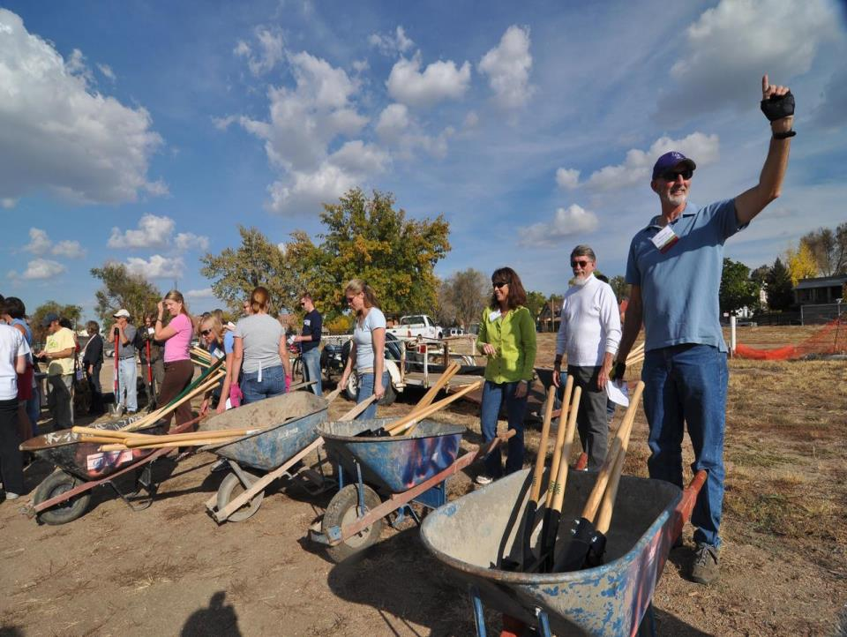
Urban Land
Institute

Slide 2
ULI: Who We Are and How We Work
Mission: To provide leadership in the responsible use of land and in creating and sustaining thriving communities worldwide.
ULI is comprised of over 30,000 members and a network of 71 District and National Councils.
ULI Priorities:
Advising communities in need
Shaping cities and regions
Developing excellence through education
Driving innovation in real estate and urban development
Building sustainably
Connecting capital and the built environment

Slide 3
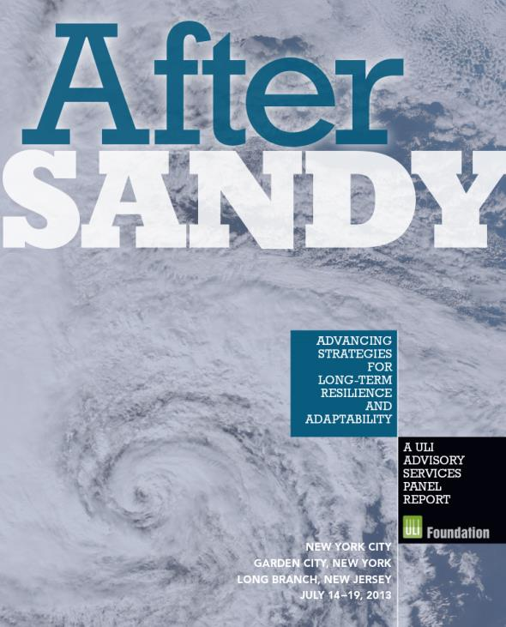
Help Communities in Resiliency Planning
25 member ULI panel
“Future Responders”
Focused on long-term strategic resilience

Slide 4
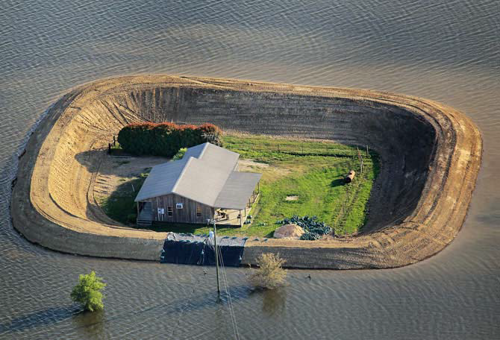
Keys to Good Governance
Regional coordination
Local decision making
Knowledge sharing

