Slide 2
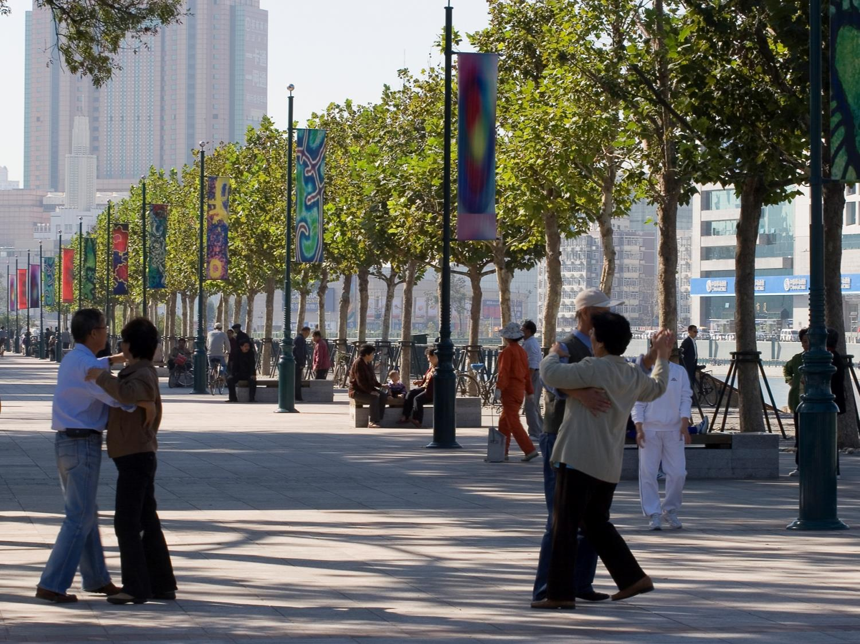
Citizen to Live
Provide basic needs and balanced provision of urban resources (food, water, transportation, education, healthcare, safety, etc.)
Humanistic scale communities
Social equality
Promote awareness and strengthen public engagement
PCSI 2014
Integrated Planning for Resilient & Livable Cities

Slide 3
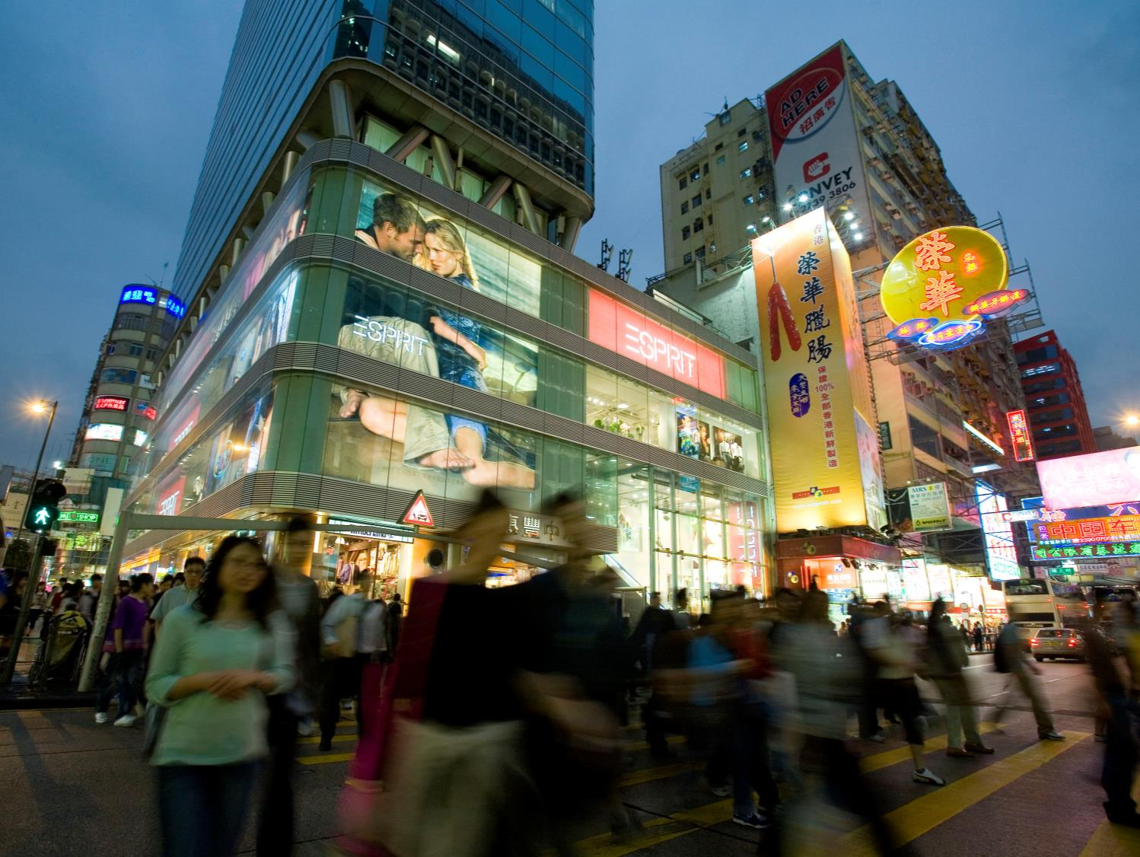
Business to Invest
Innovative regulatory schemes to govern development
Competitive market yet fairness
Humanistic social environment to attract and retain talents
Promote public private partnership
PCSI 2014
Integrated Planning for Resilient & Livable Cities

Slide 4
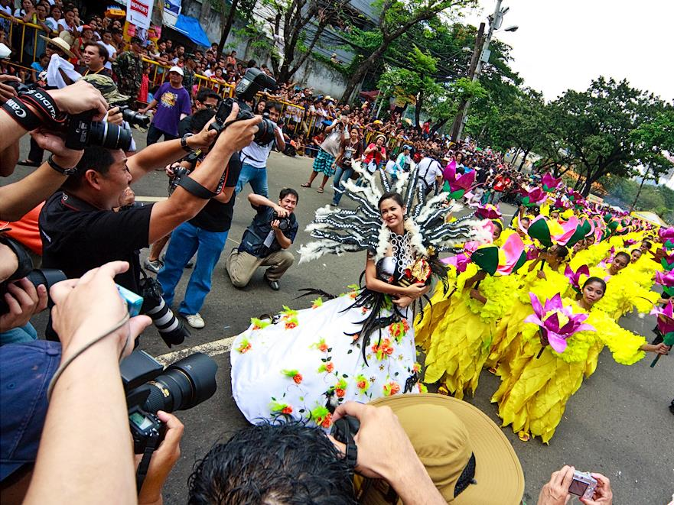
Cultures to Celebrate
Encourage inclusiveness and diversity
Embrace a dynamic cultural and religious social environment
Urban heritage preservation
New lifestyles
PCSI 2014
Integrated Planning for Resilient & Livable Cities

Slide 5
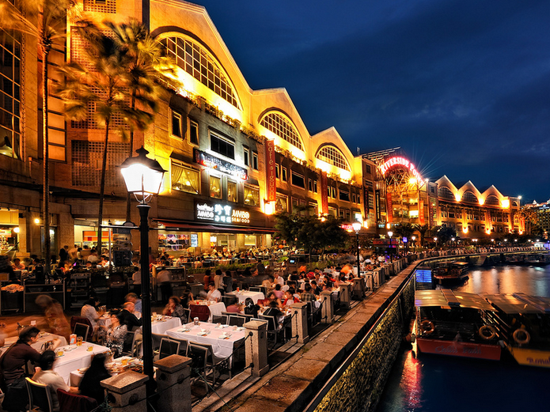
Visitors to Enjoy
Accessibility
City image to illustrate unique identity
Strengthen software development (services, events, information, etc.)
Mixed recreational and culture entertainment
Safety
Quality of Environment
PCSI 2014
Integrated Planning for Resilient & Livable Cities

Slide 6
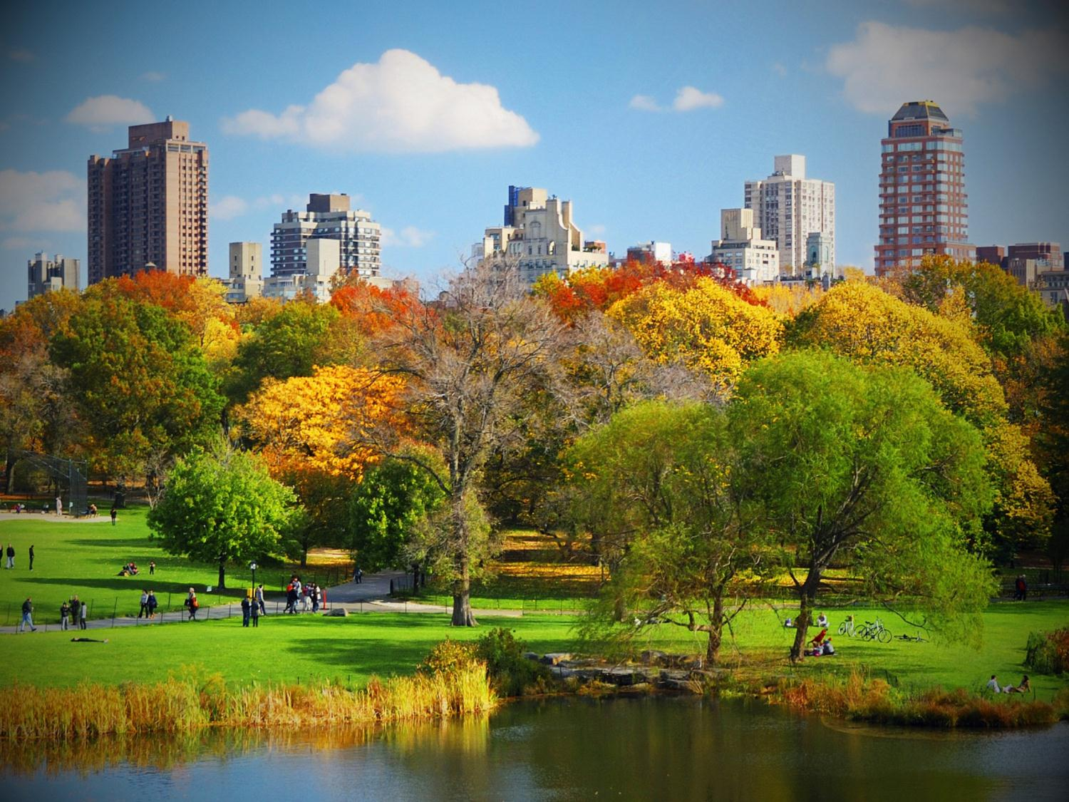
Nature to Thrive
Green infrastructure
Ample public realm
Reducing energy consumption as well as alternative energy strategies to tackle the increasing demand
Clean, reliable water supply and waste water management
Bio diversification
PCSI 2014
Integrated Planning for Resilient & Livable Cities

