Slide 1

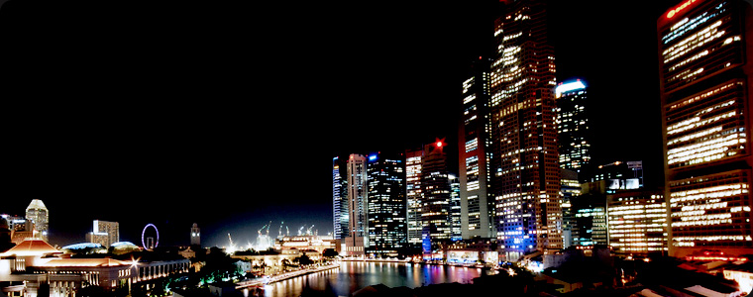
YourSingapore – The next Chrysalis
(A Choice Destination for Tourism Investments)
23 June 2011
Meeting with GLA Hotel (6 Sept 2010)

Slide 2

Tourism Sector Performance
Tourism Receipts (S$b)
S$22 – 24b
2011 Forecasts:
12 – 13m visitors
18.8
15.2
14.1
$22 – 24b tourism receipts (~ KRW 19 – 20 tril)
12.4
12.4
12 – 13m (Visitor Arrival)
11.6
Visitor
Arrivals (m)
10.3
9.8
10.1
2010 – Best Year Ever Performance
S$18.9bil (~KRW 16 tril) Tourism Receipts (49% over 2009)
11.6mil Visitors (19% over 2009)
9.7
2006
2007
2008
2009
2010
2011
Notes:
Strong rebound in tourism for 2009 – 2010.

Slide 3
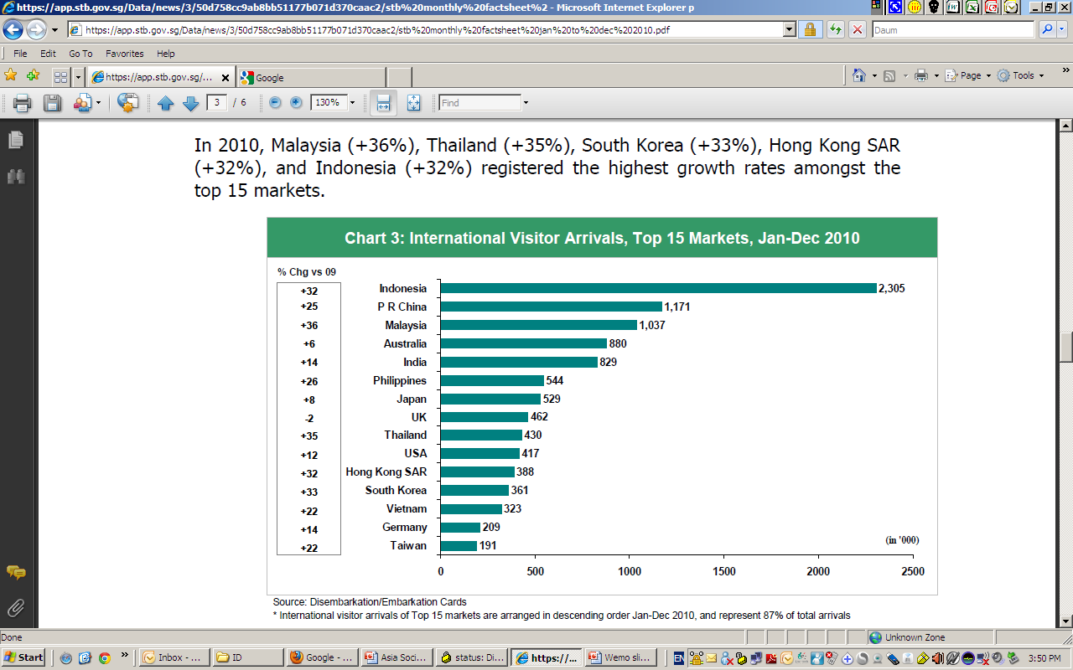
International Visitor Arrivals: Top 15 Markets, Jan - Dec 2010
In 2010, Malaysia (+36%), Thailand (+35%), South Korea (+33%), Hong Kong SAR (+32%), and Indonesia (+32%) registered the highest growth rates amongst the top 15 markets.

Slide 4
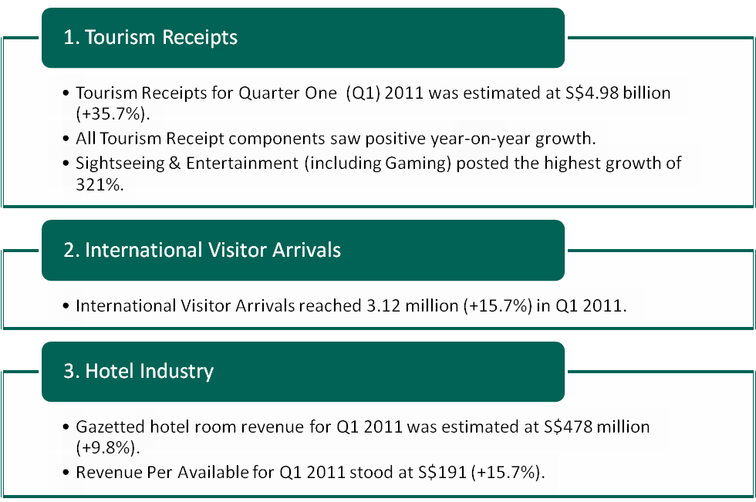
Highlights of 1st Quarter 2011
(KRW 5.6 trillion)
(KRW 538.5 billion)
(KRW 215,199)

Slide 5
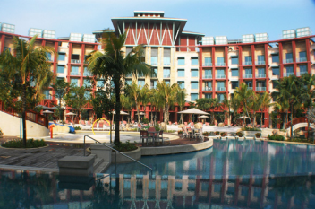
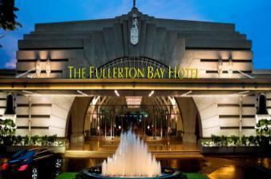
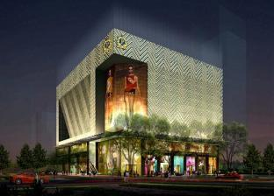
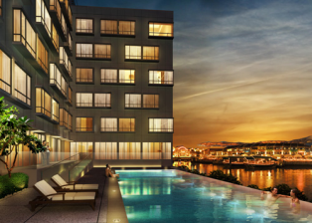
Hotel Industry 2010…
Marina Bay Sands
Greater diversity; stronger design element; differentiated experiences
Revenue Per Available Room and Average Occupancy Rate signal healthy hotel industry performance
23 hotels opened in 2010, including:
  Marina Bay Sands
  Santa Grand Hotel Chinatown
  Park Regis Singapore
  Grand Park Orchard Hotel
  Best Western Jayleen 1918
Hard Rock Hotel @ RWS
The Fullerton Bay Hotel
Grand Park Orchard Hotel
Park Regis Singapore
Notes:
For info:
Total of 3 sites in 2010:
27 Oct 2010: Award of tender for commercial/hotel site at Stamford/North Bridge Road
3 Sep 2010: Award of tender for hotel site at Clemenceau Avenue/Havelock Road
22 Nov 2010: Award of white site (Commercial.Hotel & Residential use) at Peck Seah Street/Choon Guan Street

Slide 6
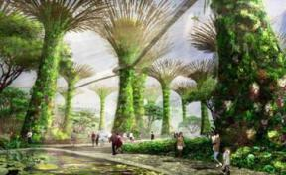
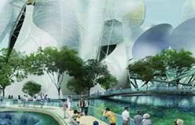
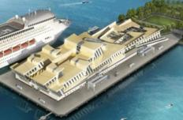
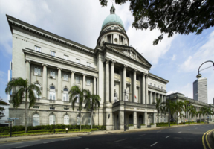
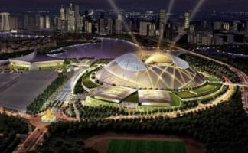
Snapshot of Upcoming Tourism Developments
2012 onwards
Gardens by the Bay
River Safari
Marine Life Park @ RWS
2013 onwards
2014 onwards
Int’l Cruise Terminal
National Art Gallery
Sports Hub

Slide 7
Potential & Upcoming Tourism Development

Slide 8
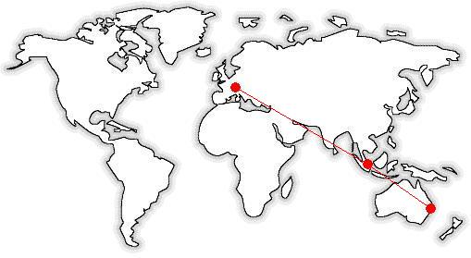
Re-Defining Our Visitor Experience
Differentiation: Sustaining a pipeline of bold and original ideas
Personalisation: Responding to the growing Asian consumer market
Concentration: Increasing the concentration of experiences to achieve synergies
Increased Yield: Pushing for higher yield instead of volume
Singapore

Slide 9
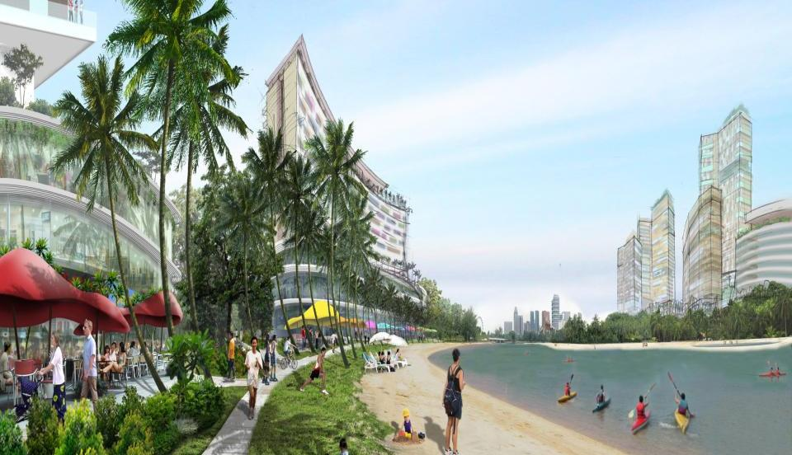
Greater Kallang Riverside

Slide 10
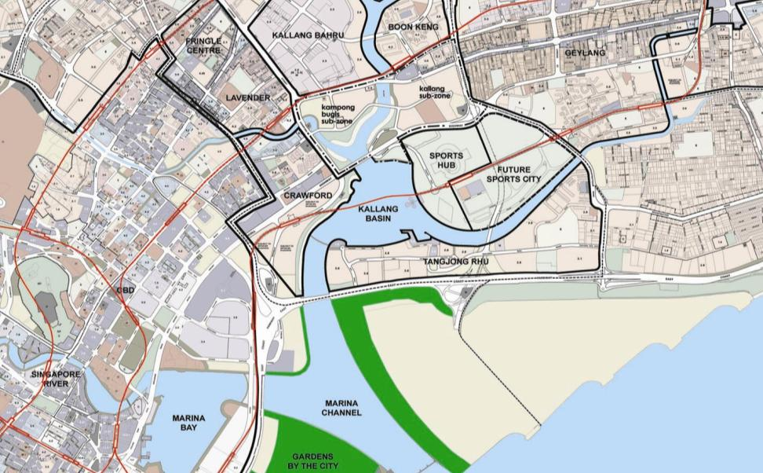

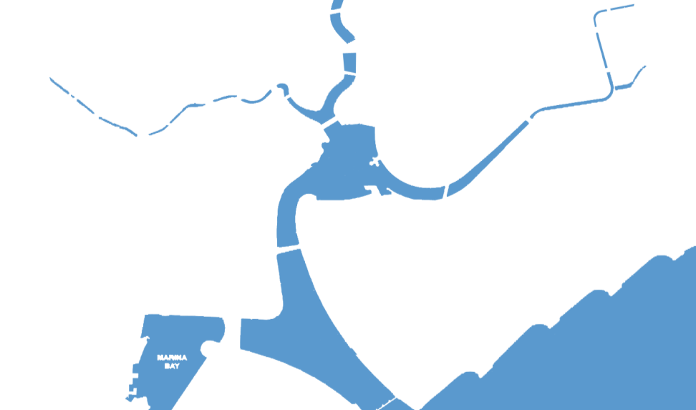
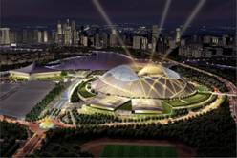
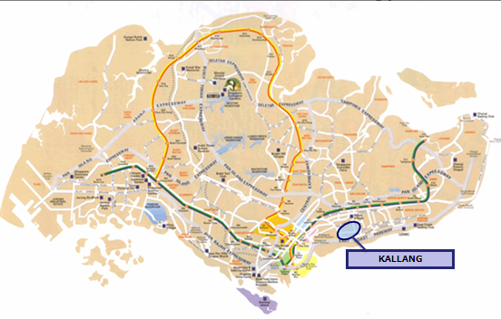
Greater Kallang Riverside:
Good Location, Accessibility and Near other Tourism Zones
_{Kallang Bahru}
20 mins from Airport
_{Lavender}
_{Geylang}
_{Kallang Riverside}
_{Sports Hub}
10 mins to City
_{Crawford}
_{City Centre}
_{Tanjong Rhu}
Opening 2014
Notes:
The site is located at Kallang Basin with an estimated 2km of prime water frontage along the Rochor and Kallang Rivers.

Slide 11
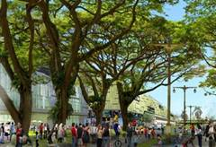
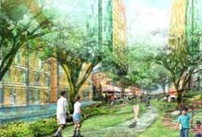
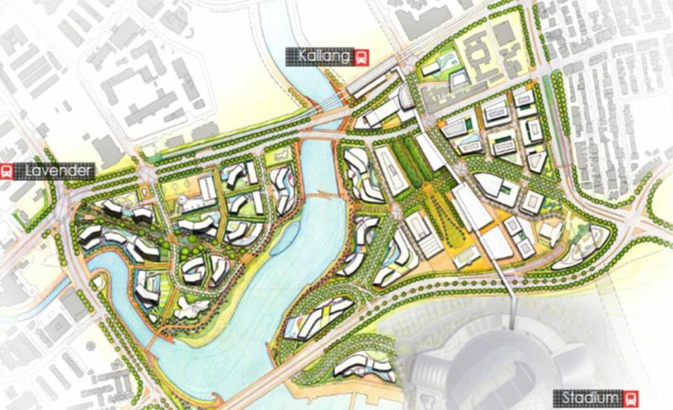
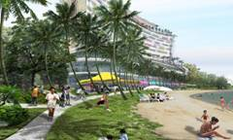
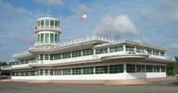


Greater Kallang Riverside (99ha)
Old Airport Square (2014)
Lush Residential Precinct
(4,000 waterfront homes)
Landmark Devt
Mixed-Use Hub
(Beyond 2014)
A
Historic Green
B
Residential
The Green
Kallang River
Residential
Beachfront Attractions/Hotels
Conserved Airport Buildings
Sports Hub (2014)
Beachfront Attractions & Water Sports Activities
Waterfront Hotels (2011-2014)
Notes:
- Red Dotted area outlines the Old Airport square area. The blue blocks within the red-dotted area refer to potential landfills that can be built around the existing buildings.
- Purple areas are beachfront sites earmarked for beachfront attractions and hotels. (Artificial beach to be created)
- A & B are hotel sites on the reserve list i.e. it must be activated with the submission of a bid which is above the reserve price in order to kickstart the tender process.
- Landmark site is white site slated for Office, retail, mixed use. Currently, URA has not decided what to do with it yet, but there's an ongoing discussion now whether it should be included for the potential RFP for Old Airport Square
- Potential catchment

Slide 12
Jurong Lake District

Slide 13
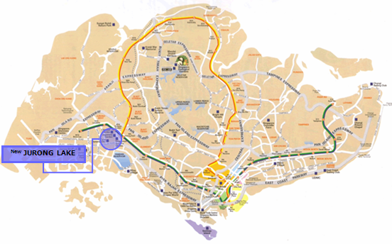
Jurong Lake District – 360 ha
  Lakeside - 220 ha of land
  - 70 ha of water
  Gateway - 70 ha of land
Notes:
Singapore

Slide 14
Jurong Lakeside – New Tourism Energy Zone
Notes:
Jurong Lakeside – this is where STB is coming in to see to the development of a new tourism energy zone.

Slide 15
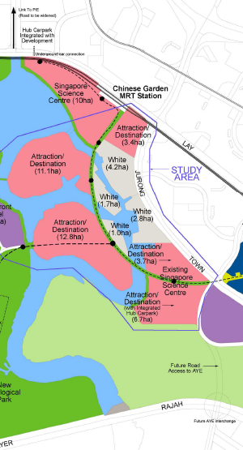
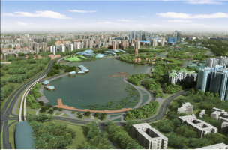
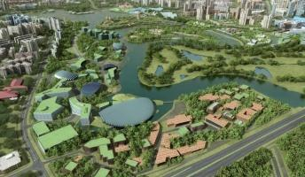
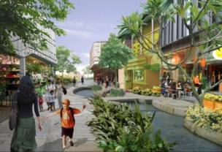
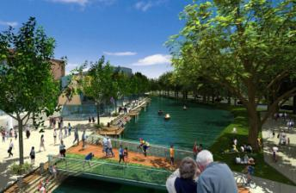
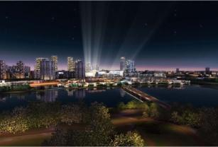
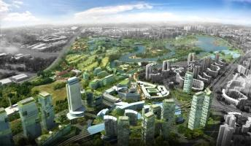
Vision for Jurong Lakeside
A must-visit waterfront family destination, offering world-class EDUtainment experiences in a sustainable environment.
Chinese Garden Site: 12.8 ha
Site A: 10.4 ha
Japanese Garden Site: 13.8 ha
LAKESIDE
Jurong East
A compelling mix of unique anchor attractions, with strong educational focus, high interactivity and entertainment value, thematic accommodation, F&B, retail and entertainment facilities for all ages
Notes:
2.3 million visitors in 2015 to cluster (inclusive of locals)
Estimated Investment of $460 million (current day cost)
Create 1000-1300 jobs in 2015
Conservation of Chinese and Japanese Garden

Slide 16
Proposed Jurong Lake District Development Timeline
Timeline | Milestones
2012 | Launch Sites
2013-2015 | Phased completion of development
Notes:
16

Slide 17

Thank You!

